Slide 1
MODULE-II
OUALITY PLANNING AND DEVELOPMENT
2. MATERIALS AND
SALES MANAGEMENT

Slide 2
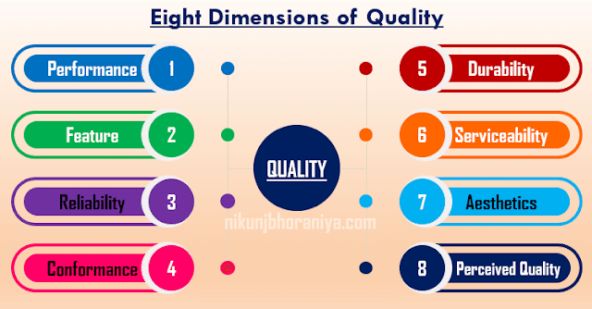

Slide 3
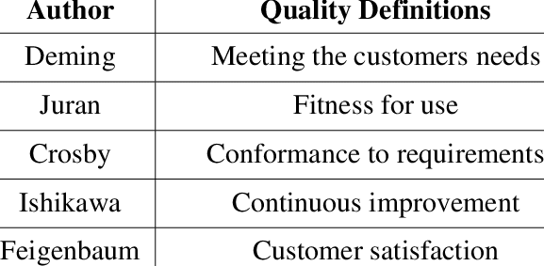

Slide 4
QUALITY PLANNING
Quality planning is one of the basic processes used in managing for quality.
It is the process of establishing quality objectives and developing the means (plans) for meeting those objectives.
Quality planning is the activity of developing the products and processes required to meet customer's needs.

Slide 5
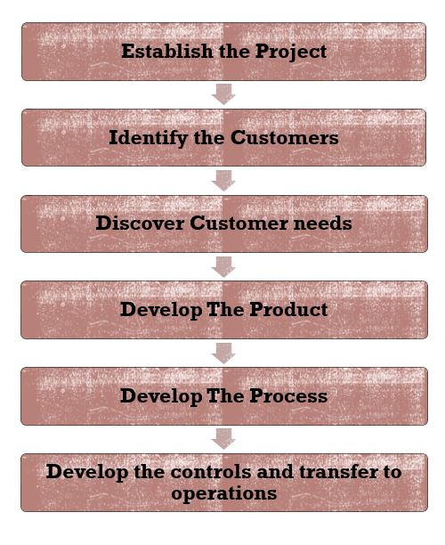
STEPS INVOLVED IN QUALITY PLANNING

Slide 6
OBJECTIVES OF QUALITY PLANNING
1.To produce quality products and services which meet customer's needs.
2.To identify quality standards and to prepare product specifications.
3.To prepare guidelines on various elements affecting quality.
4.To establish quality objectives and developing plans for achieving these objectives.
5.To have quality assurance system through every individual in every functional group of the organization.

Slide 7
OBJECTIVES OF QUALITY PLANNING (Cont…)
6.To review and evaluate product designs with a view to improve quality and reduce the quality costs.
7.To develop the quality control techniques and methods.
8.To build up a basis for total quality management culture.
9.To identify opportunities for excellence.
10.To create an excellent operating culture in the organization.

Slide 8
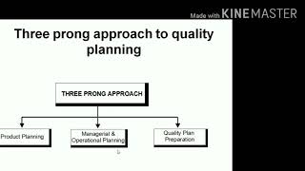


Slide 9
THREE PRONG APPROACH
1.Product Planning: Evaluation of the range mix, specification and pricing of existing and new products in relation to present and future market requirements and competition.
2. Managerial and Operational Planning: It involves the following-
(a) Preparing organizational structure
(b) Preparing organizational procedure.
(c) Preparing process
(d) Preparation of resources needed to implement quality management.

Slide 10
THREE PRONG APPROACH (Cont….)
3.Documentation : All the elements , requirements and provisions adopted by company for its quality management system should be documented in a systematic and orderly manner in the form of written policies and procedures.

Slide 11
QUALITY MANAGE MENT SYSTEM
A quality management system is defined as a system to direct and control an organization with regard to quality.
OR
A system to establish quality policy and quality objectives and to achieve those objectives.

Slide 12
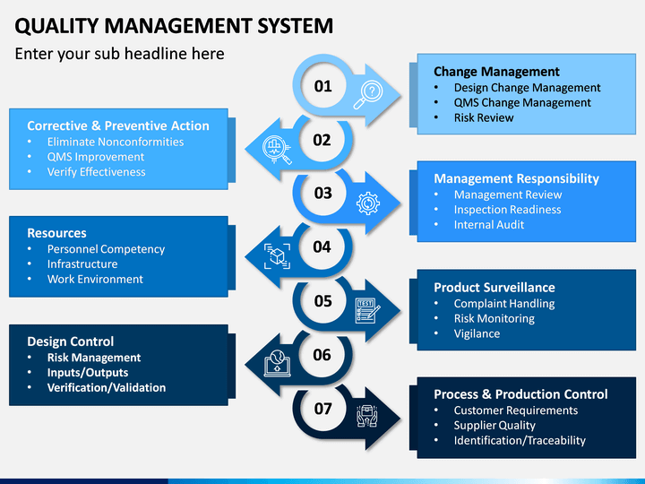

Slide 13
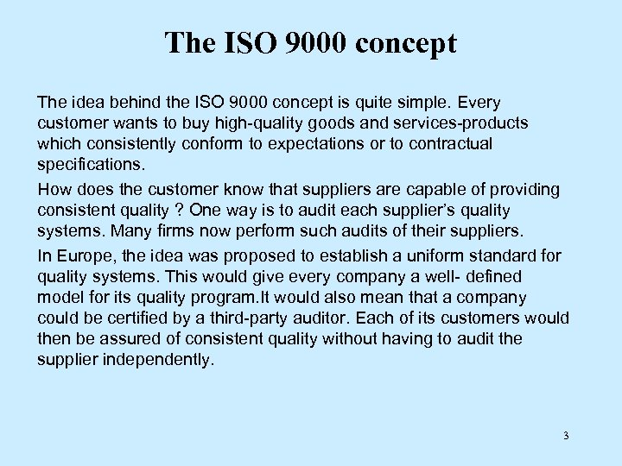

Slide 14
What is ISO 9000?
ISO 9000 is a family of standards for quality management systems, maintained by ISO ,based in Geneva. The ISO 9000 series of standards promotes the adoption of process approach when developing, implementing and improving the effectiveness of a quality management system to enhance customer satisfaction by meeting customer's requirements.

Slide 15
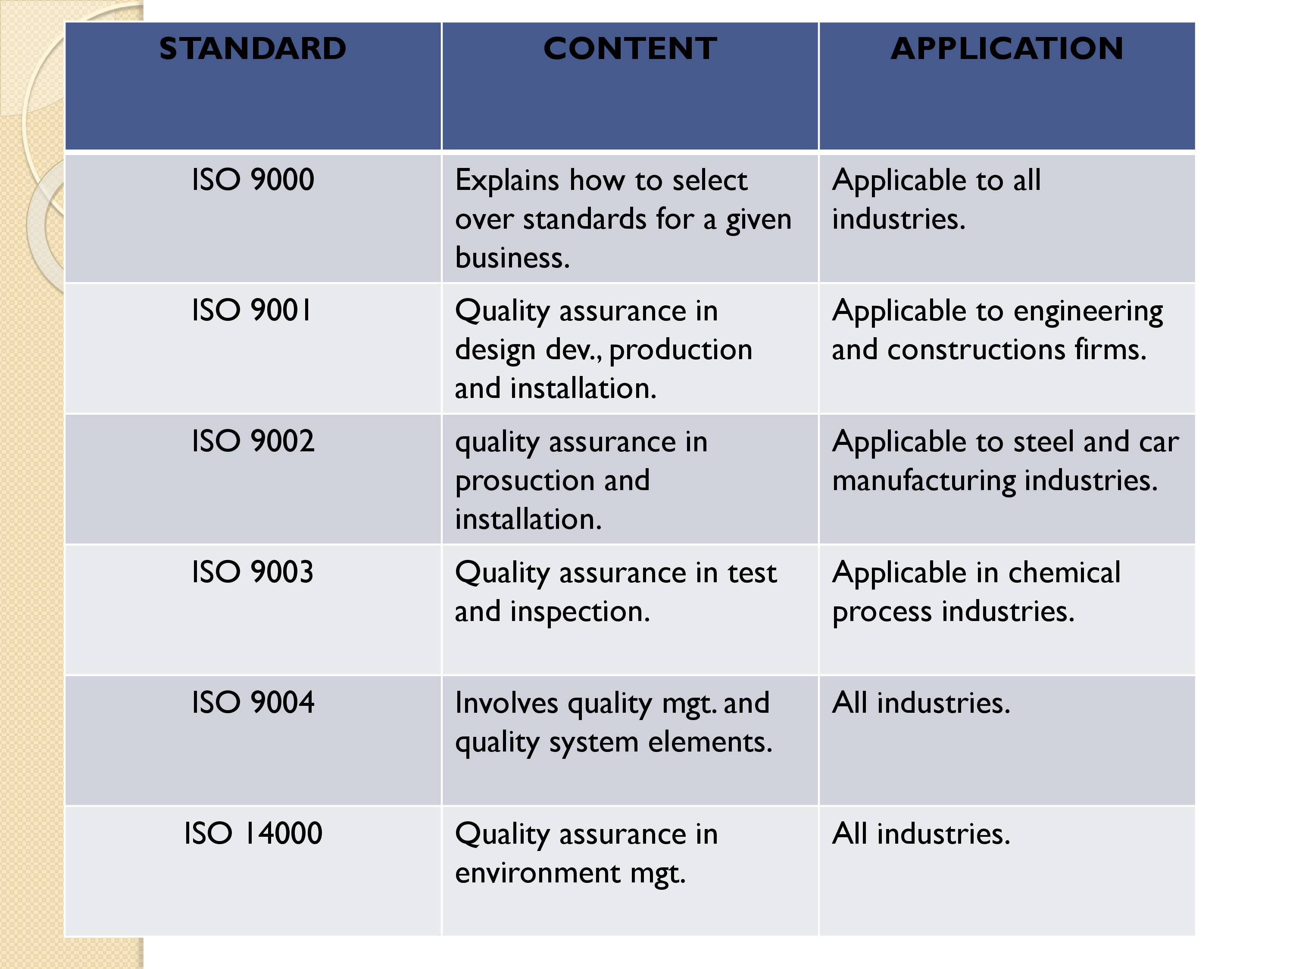
ISO 9000 SERIES

Slide 16


Slide 17
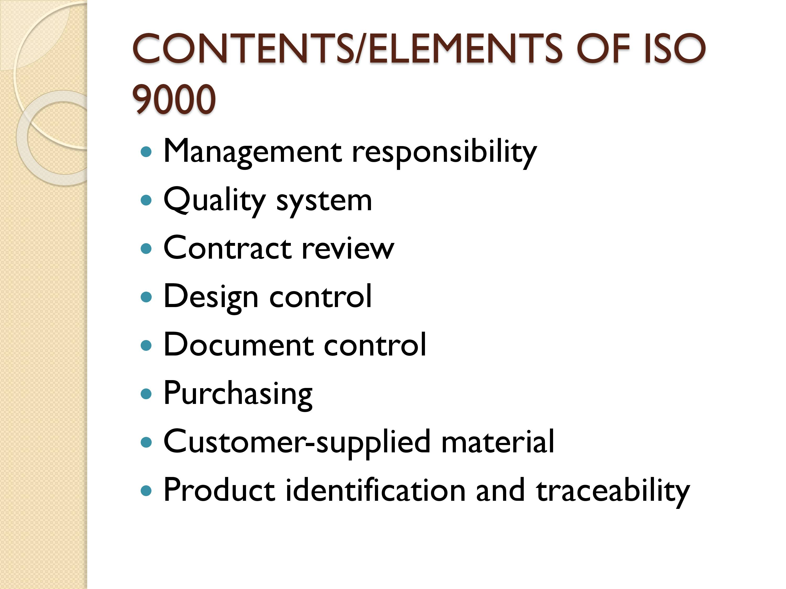

Slide 18
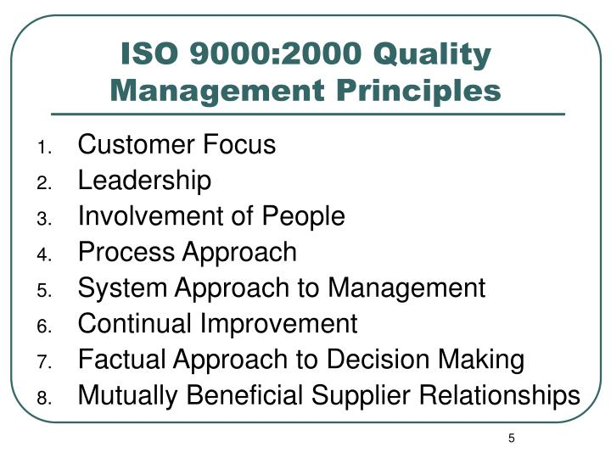

Slide 19
STEPS FOR INSTALLATION OF ISO 9000
1. Preparatory Step
2. Implementation Step
3. Registration and
Certification Step

Slide 20
STEPS FOR INSTALLATION OF ISO 9000 (Cont….)
These simple steps can prove to be an effective guide to obtaining ISO 9000 registration:
Get top management commitment
Train personnel
Prepare Quality Policy Manual
Prepare Operating Procedures
Hold internal audit
Select registrar
Go through registration process
Obtain ISO 9000 registration

Slide 21
QUALITY AUDIT

Slide 22
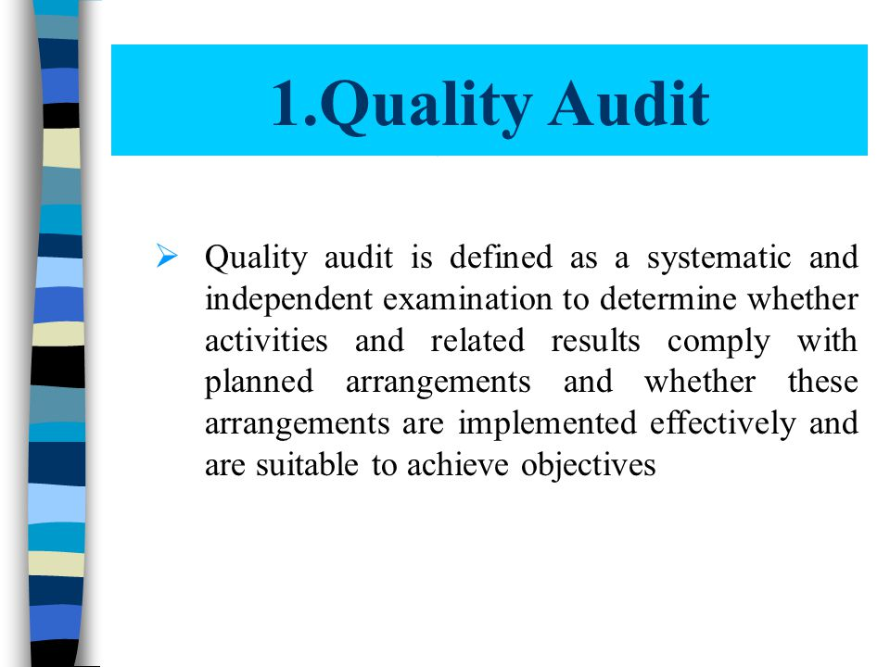

Slide 23
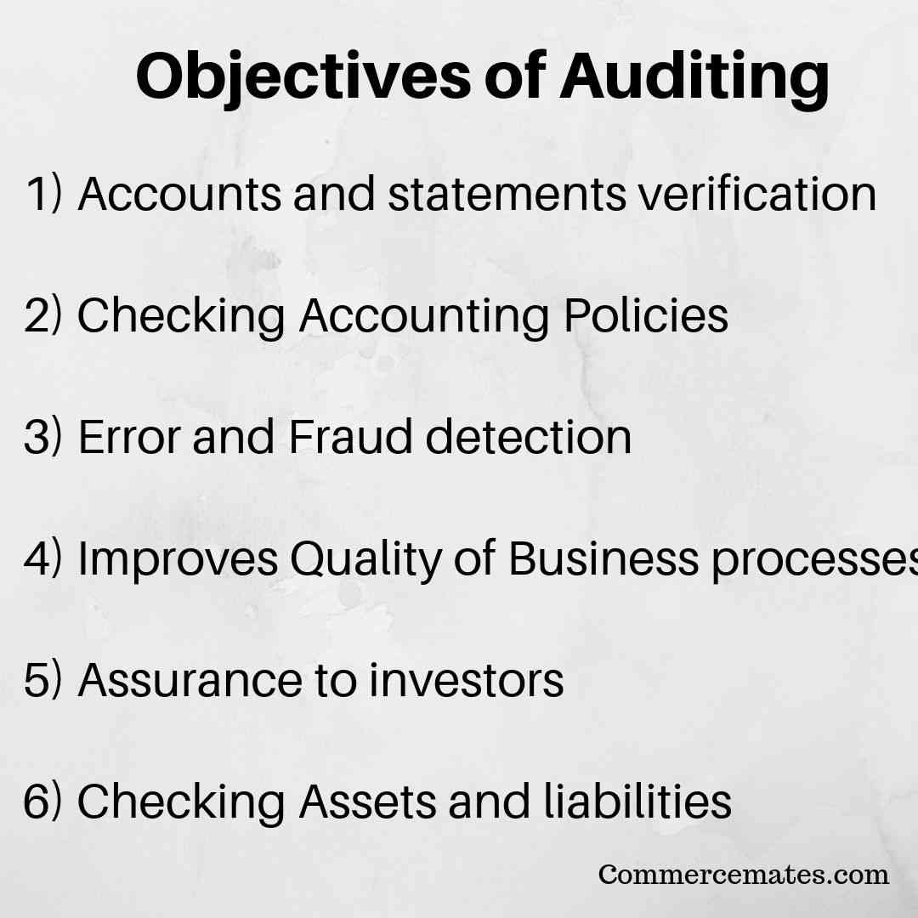

Slide 24
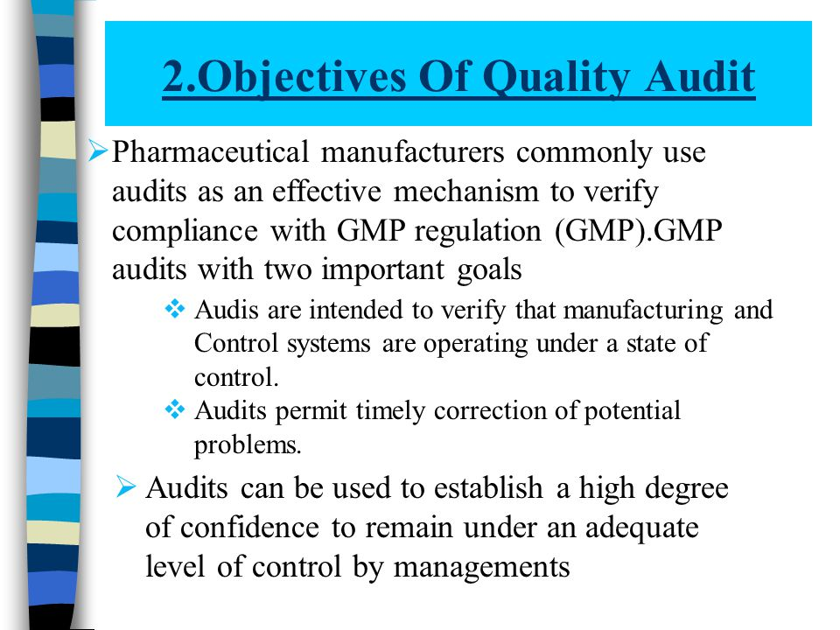

Slide 25
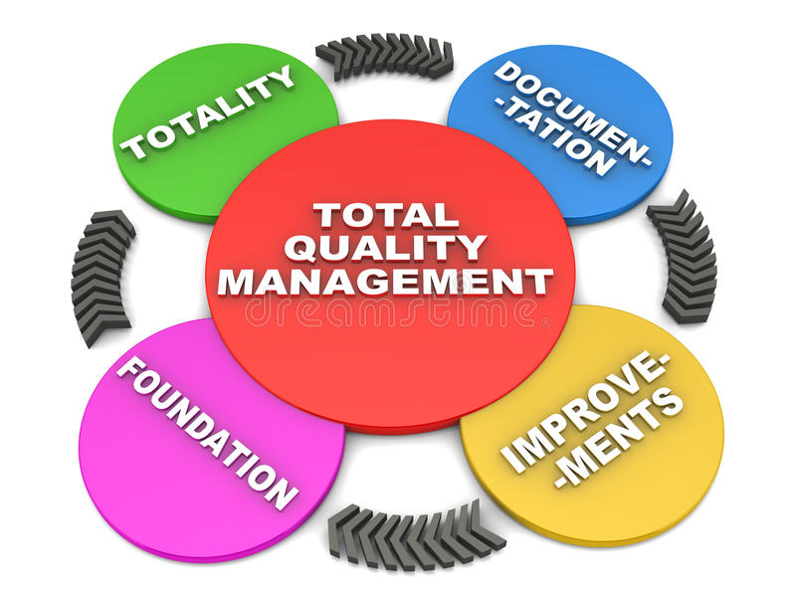

Slide 26
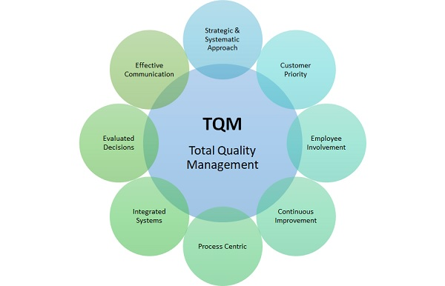

Slide 27
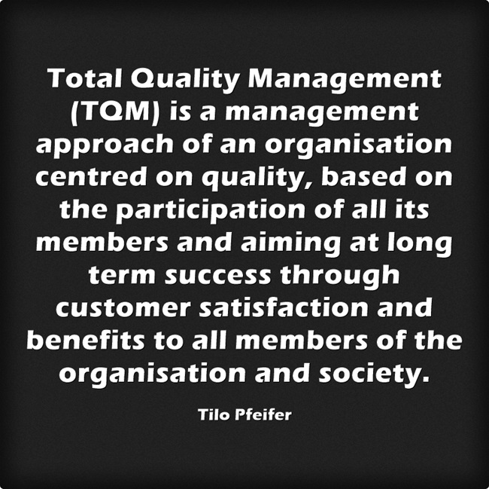

Slide 28
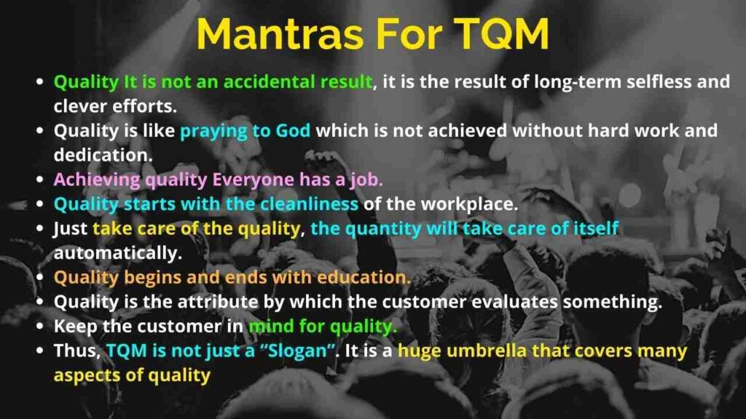

Slide 29
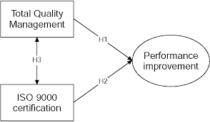
LINK BETWEEN ISO 9000 & TQM

Slide 30
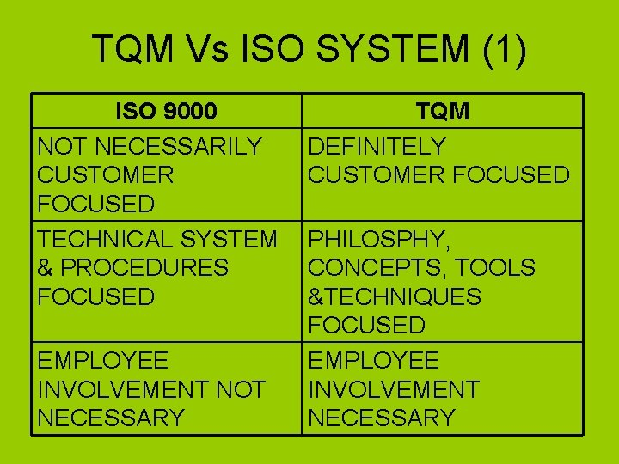

Slide 31
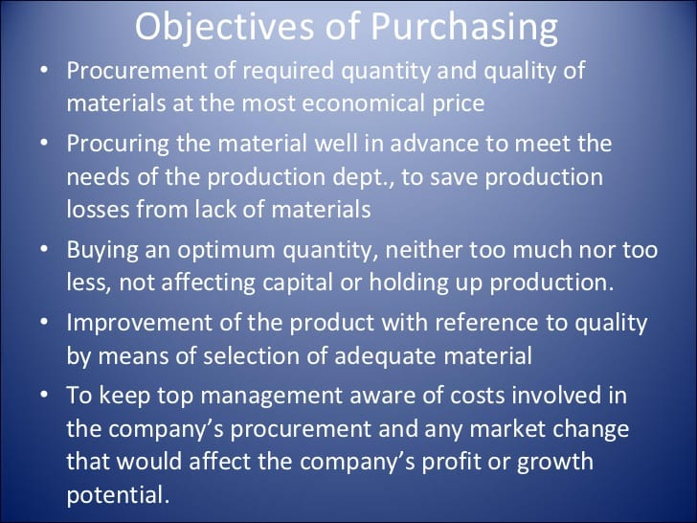

Slide 32
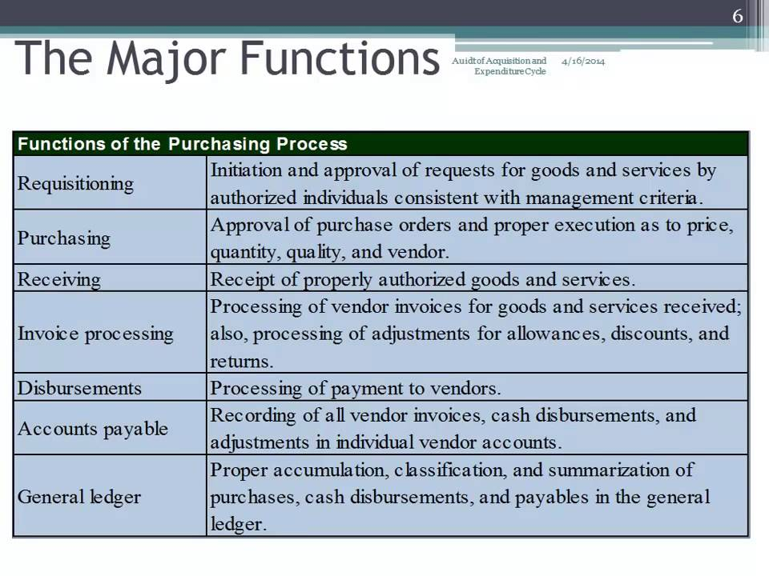
FUNCTIONS OF PURCHASING DEPT.

Slide 33
METHODS OF PURCHASING
1.Purchasing by Requirement.
2.Purchasing for a specific future period
3.Market purchasing
4.Speculative purchasing
5.Contract purchasing
6.Central Purchase Organization
7.Through Directorate General of Supplies and Disposal.

Slide 34
1. PURCHASING BY REQUIREMENT
The required quantity og materials for any particular job are purchased, when the job is in hand.
This method is suitable for the industries having less working capital.

Slide 35
2. PURCHASING FOR A SPECIFIC FUTURE PERIOD
The materials are purchased in bulk for a specific future period to maintain the flow of production.
The standard items which are in regular use are purchased by this method.

Slide 36
3. MARKET PURCHASING
This type of purchasing is generally made to take advantage of price fluctuations. Raw materials are generally purchased on this basis.
When the raw materials are available at low price, they are procured in bulk quantities, to get greater margin of profit in finished goods.
This is suitable in case of goods involving major fluctuations.

Slide 37
4.SPECULATIVE PURCHASING
The purchases are made not according to requirement, but they are made with a view that there will be a greater demand for the product in future.
Purchases are made in excess of actual requirements.
This is not a scientific method.

Slide 38
5. CONTRACT PURCHASING
Contracts are given to suppliers for large amounts of future requirements, for a certain period (say 2,3 years), subject to review and cancellation with an appropriate period of notice.
While calling quotations, the approximate quantity and time etc. are specified.
Many concerns that use large quantities of basic materials such as pig iron, coal etc. have found it very suitable.

Slide 39
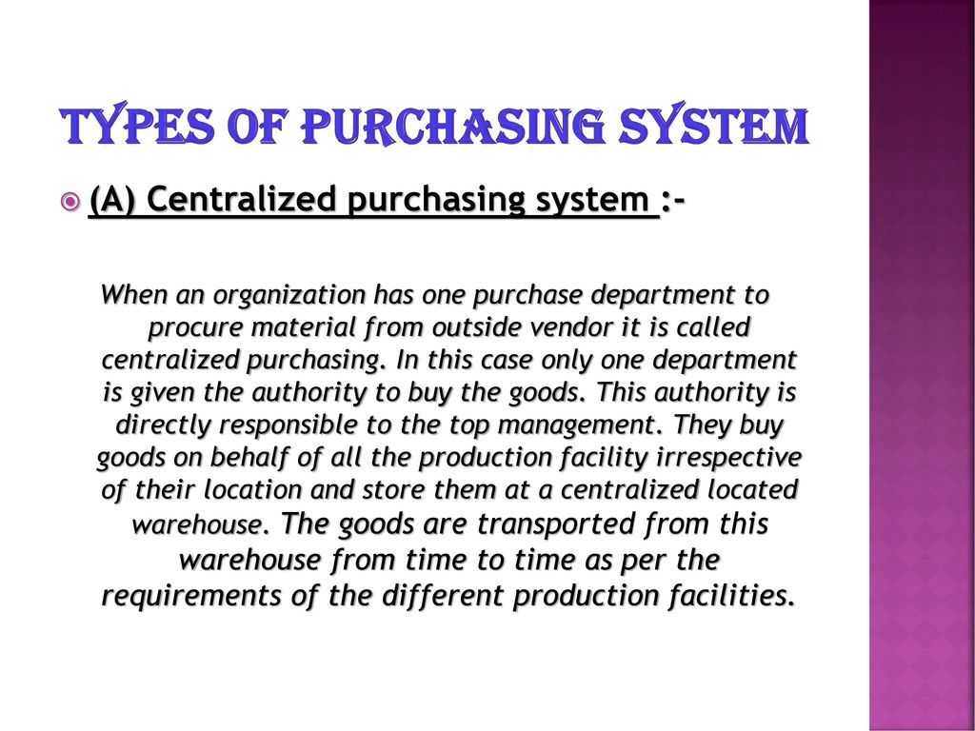
6. CENTRAL PURCHASE ORGANIZATION

Slide 40
7.THROUGH DIRECTORATE GENERAL OF SUPPLIES AND DISPOSAL
The DGSD provides supply of different products at relatively cheaper rates for different government organizations.
This dept. enters into a contract with various organizations for supply of certain materials to various government organizations during the year at agreed rates.
These suppliers have to certify that they shall not supply to other purchasers same material at lesser rate during the contract year.

Slide 41
PURCHASE PROCEDURE
1. Receipt and analysis of requirements and processing of requisitions.
2. Choice and location of potential suppliers.
3. Request, Receipt and Analysis of quotations.
4. Placing of orders.
5. Follow up and expediting the purchase orders.
6. Verification of suppliers invoices for payment after processing discrepancies and rejections.
7. Closing completed orders and maintenance of records.

Slide 42
INVENTORY
It is a detailed list of movable goods, such as raw materials, materials in process, finished products, general supplies and equipments, which are necessary to manufacture a product and to maintain the equipment and machinery in good working order.
The quantity and the value of every item is also mentioned in the list.

Slide 43

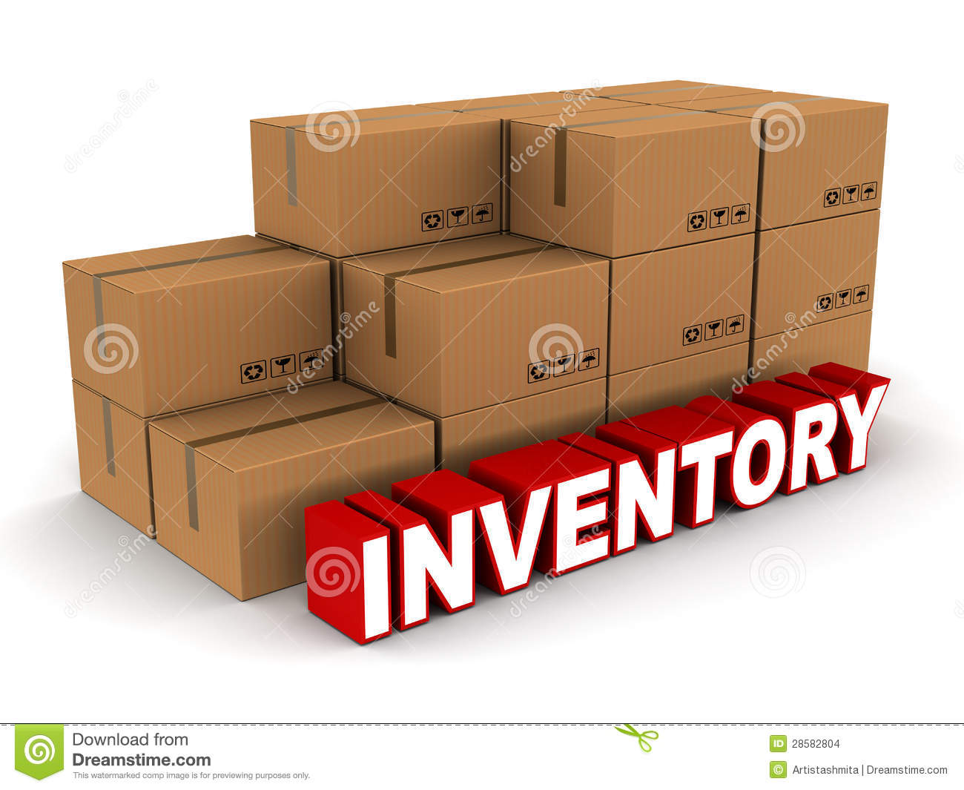
INVENTORY-IMAGES

Slide 44
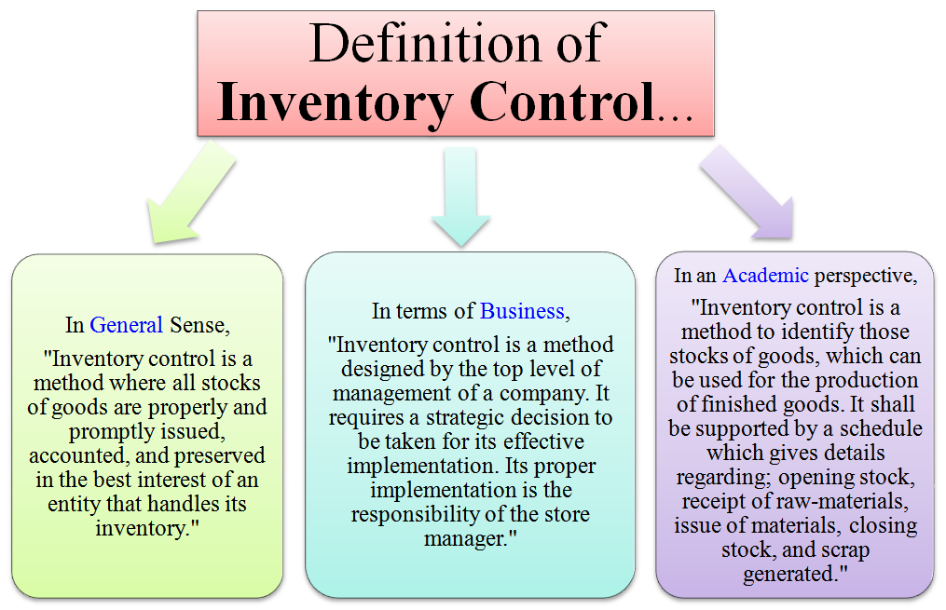

Slide 45
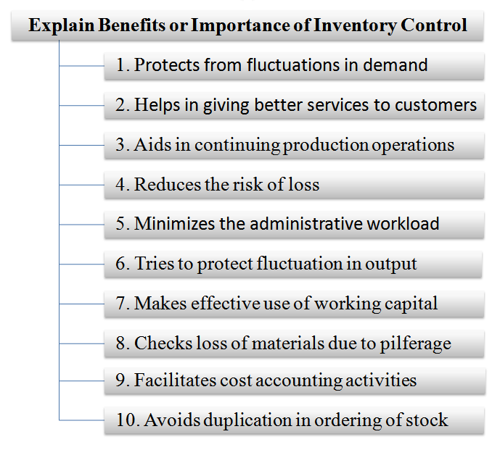

Slide 46
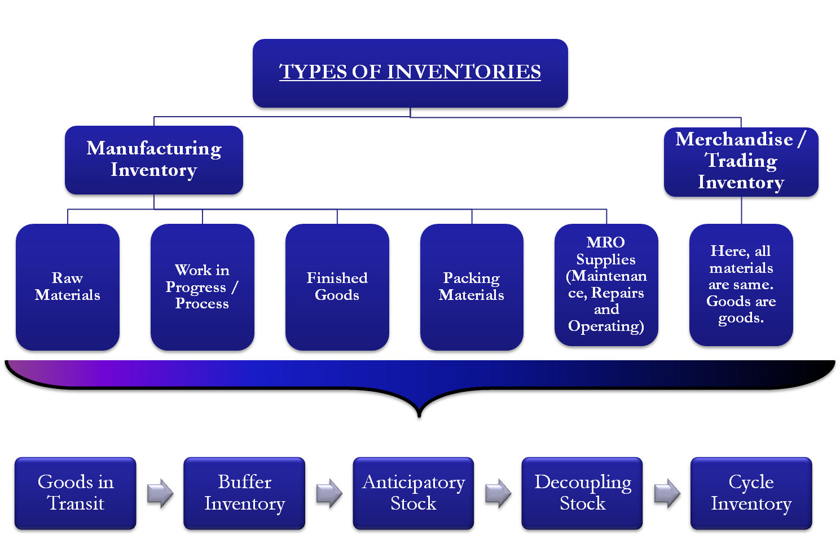

Slide 47
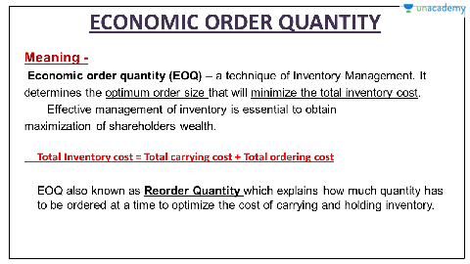

Slide 48
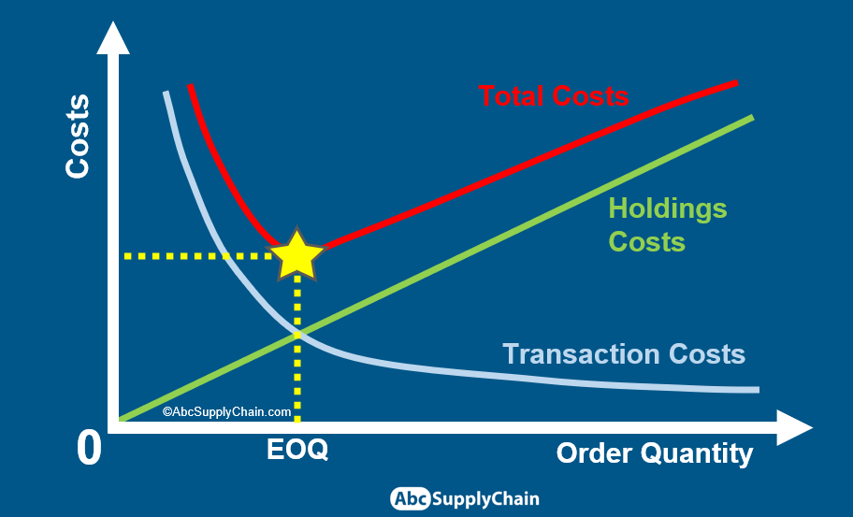

Slide 49
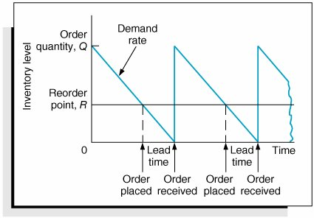

Slide 50
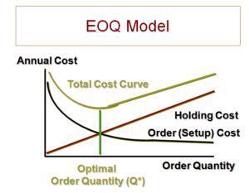
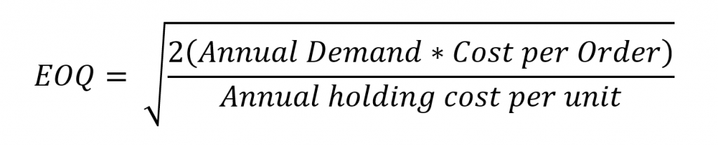

Slide 51
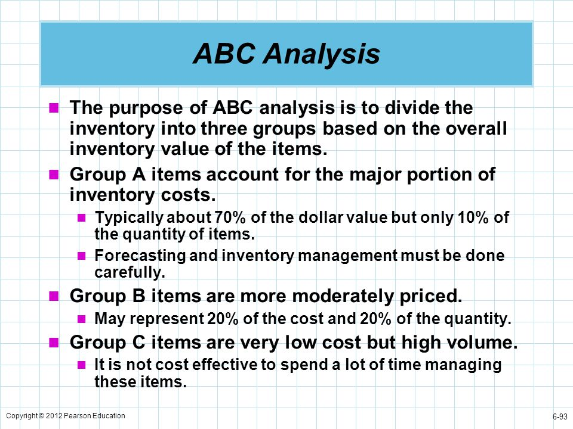

Slide 52
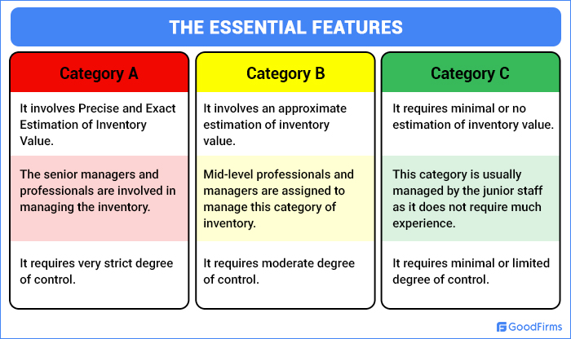
ABC ANALYSIS

Slide 53
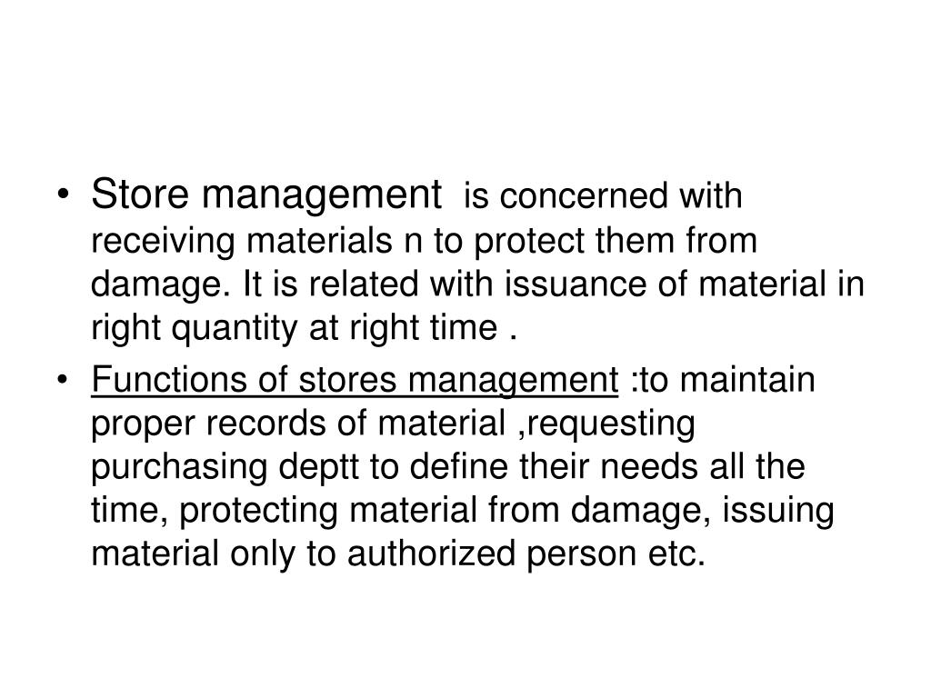
STORE KEEPING

Slide 54
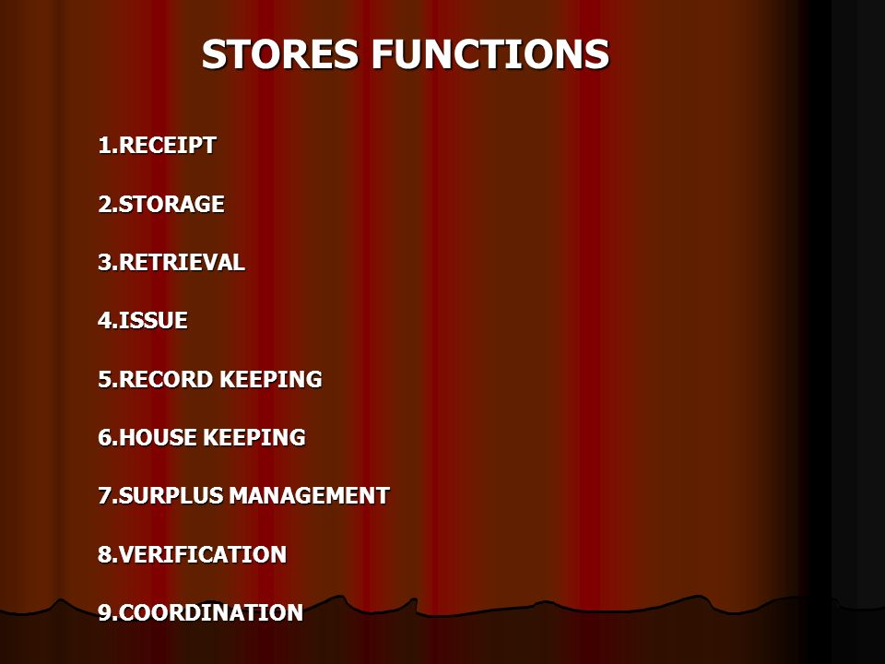

Slide 55
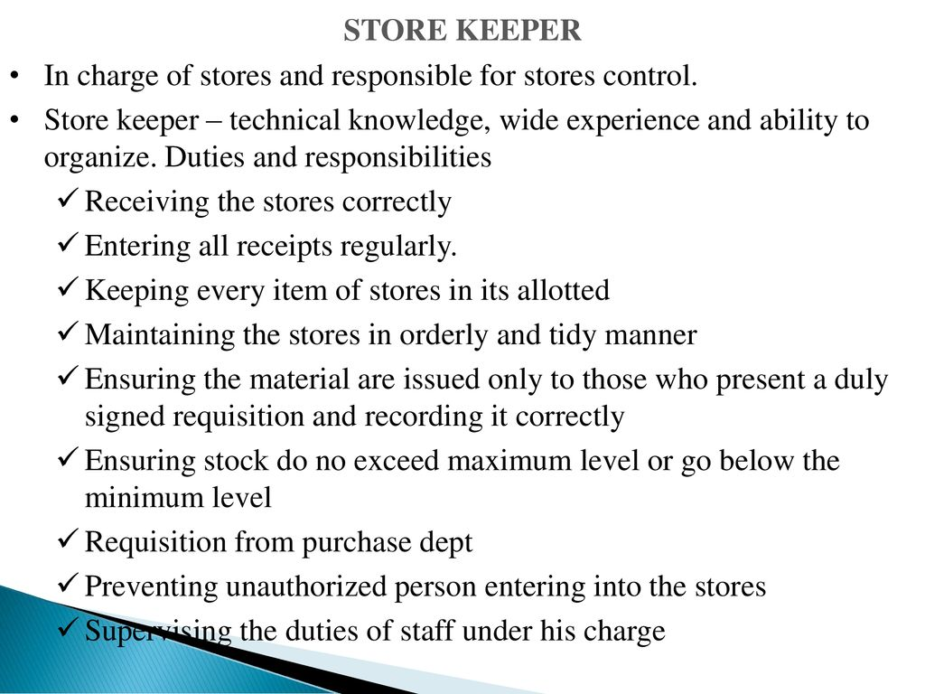

Slide 56
STORE RECORDS
1. Inward & Outward register.
2. Stock register.
3. Daily Receipt register.
4. Issue Register.
5. Store Ledger.
6. Surplus Stock Register.
7. Suspense Register.
8. Condemned Article Register
9. Loan Register.
10. Empty Containers and PackRegister

Slide 57
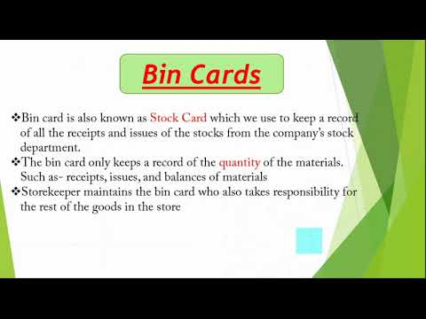

Slide 58
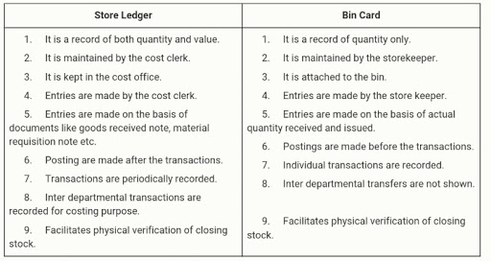

Slide 59
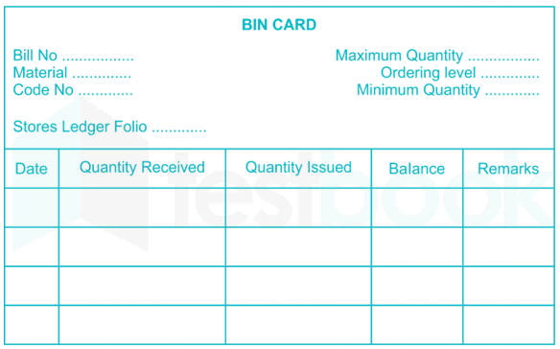

Slide 60
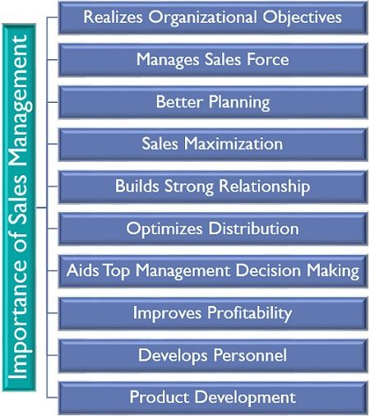

Slide 61
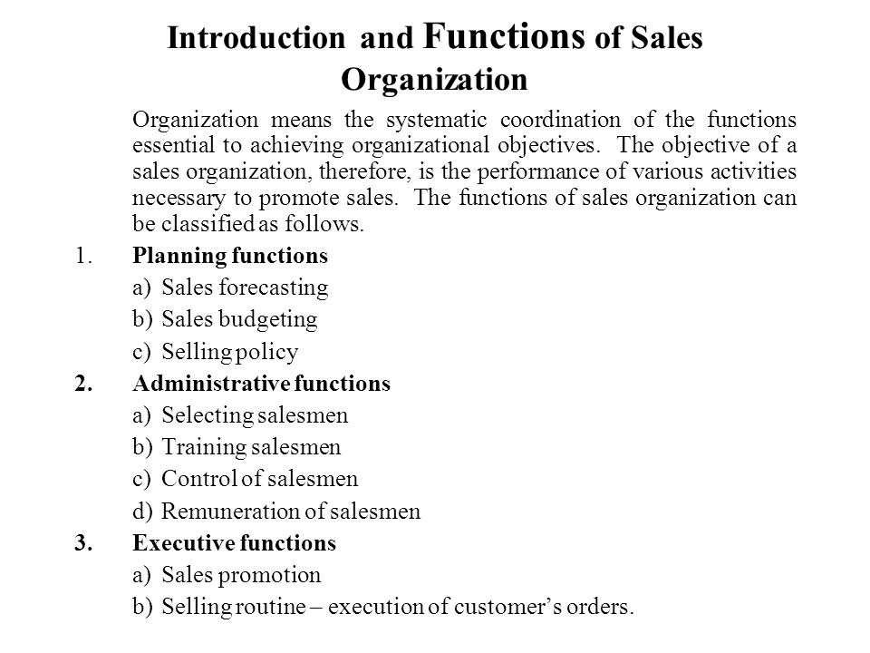

Slide 62
